Slide 1
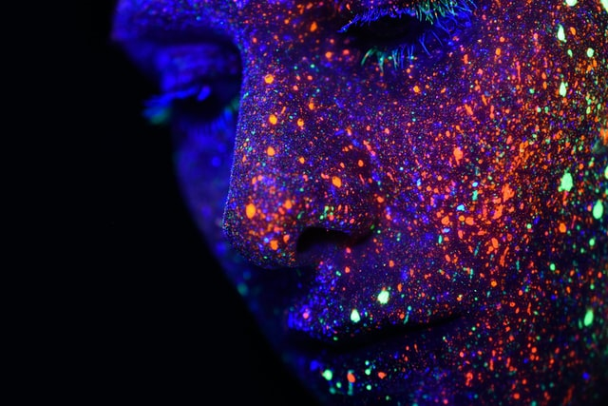
Introduction to Machine Learning
INFO 4652 5652
Dr. Osita Onyejekwe

Slide 2
What is Machine Learning
Machine learning is an application of artificial intelligence that involves algorithms and data that automatically analyse and make decision by itself without human intervention.
It describes how computer perform tasks on their own by previous experiences.
Therefore we can say in machine language artificial intelligence is generated on the basis of experience.

Slide 3
Normal Computer vs ML
The difference between normal computer software and machine learning is that a human developer hasn’t given codes that instructs the system how to react to situation, instead it is being trained by a large number of data.

Slide 4
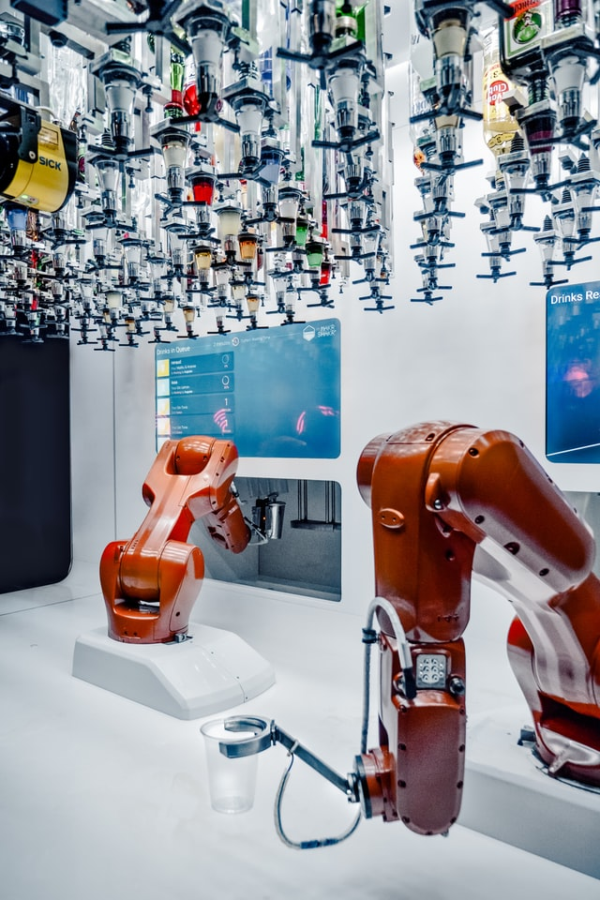
Some of the machine learning algorithms are:
Neural Networks
Random Forests
Decision trees
Genetic algorithm
Radial basis function
Sigmoid

Slide 5
Types of Machine Learning
There are three types of machine learning
Supervised learning
Unsupervised learning
Reinforcement learning

Slide 6
Machine Learning Uses:
Traffic prediction
Virtual Personal Assistant
Speech recognition
Email spam and malware filtering
Bioinformatics
Natural language processing

Slide 7
Real Time Examples for ML
TRAFFIC PREDICTION
VIRTUAL PERSONAL ASSISTANT
ONLINE TRANSPORTATION
SOCIAL MEDIA SERVICES
EMAIL SPAM FILTERING
PRODUCT RECOMMENDATION
ONLINE FRAUD DETECTION

Slide 8
Best Programming Languages for ML
Some of the best and most commonly used machine learning programs are
Python,
java,
C,
C++,
Shell,
R,
JavaScript,
Scala,
Shell,
Julia

Slide 9
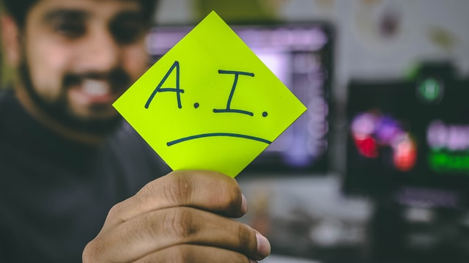

Slide 10
Difference Between Machine Learning And Artificial Intelligence
Artificial Intelligence is a concept of creating intelligent machines that stimulates human behaviour whereas Machine learning is a subset of Artificial intelligence that allows machine to learn from data without being programmed.

Slide 11
Advantages of Machine Learning
Fast, Accurate, Efficient.
Automation of most applications.
Wide range of real life applications.
Enhanced cyber security and spam detection.
No human Intervention is needed.
Handling multi dimensional data.

Slide 12
Disadvantages of Machine Learning
It is very difficult to identify and rectify the errors.
Data Acquisition.
Interpretation of results Requires more time and space.

